Slide 1
EVENT MANAGEMENT SYSTEM
Name: Pawandeep Kaur(11902499)

Slide 2
Table of Contents
S. No. | Title
1 | Objectives of EMS
2 | Tools and Technologies used
3 | Control Flow of Project
4 | Index Page
5 | Sign Up Page
6 | Login Page
7 | Admin Dashboard
8 | Organisation Dashboard
9 | Student Dashboard

Slide 3
Objectives of the EMS
To design a system which can manage the events efficiently and feasible for all types of potential users of the institution.
Institution admins should have the power to register a legit organization.
Organization should have access so that they can conduct events comfortably.
Students should have access to see the events being conducted inside university so that they can register themselves.

Slide 4
Tools and Technologies used
ASP.NET – It is a web development platform, which provides a programming model, a comprehensive software infrastructure and various services required to build up robust web applications for PC, as well as mobile devices.
SQL SERVER - SQL Server is a relational database management system (RDBMS) developed and marketed by Microsoft. As a database server, the primary function of the SQL Server is to store and retrieve data used by other applications.
Java Script - JavaScript is a scripting or programming language for web. It is widely used as part of web browsers, which allow client-side scripts to interact with the user and control the browser.

Slide 5
HTML5 - HTML5 is a Hypertext markup language used for structuring and presenting content on the World Wide Web.
Visual Studio 2019 - Microsoft Visual Studio is an integrated development environment (IDE). It's used to make websites, web apps, web services, and mobile apps, among other things.

Slide 6
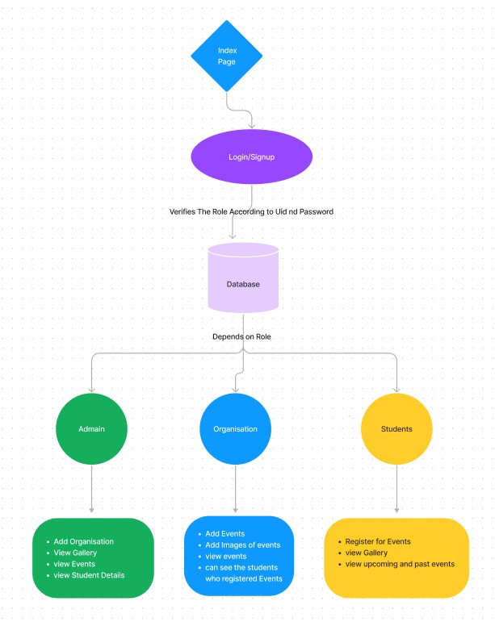
Control Flow of Project

Slide 7
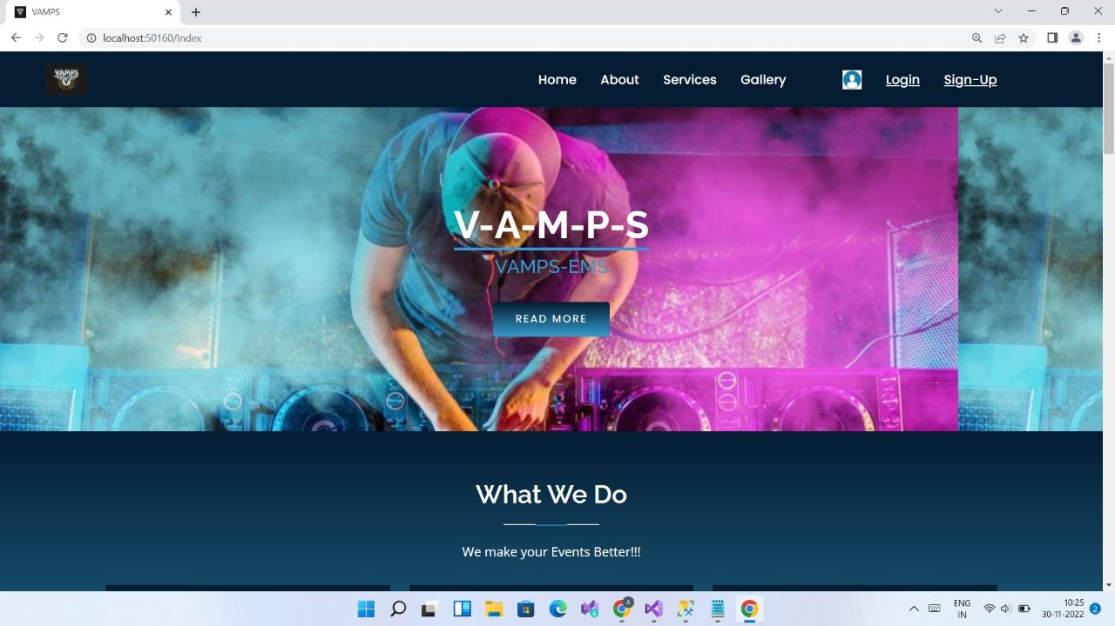
Index Page
This is index page of website which has navbar, content and footer. There are various sections of this page which shows various services provided by the website. There is a option for register and sign up by which user can sign up and after that they can login.

Slide 8
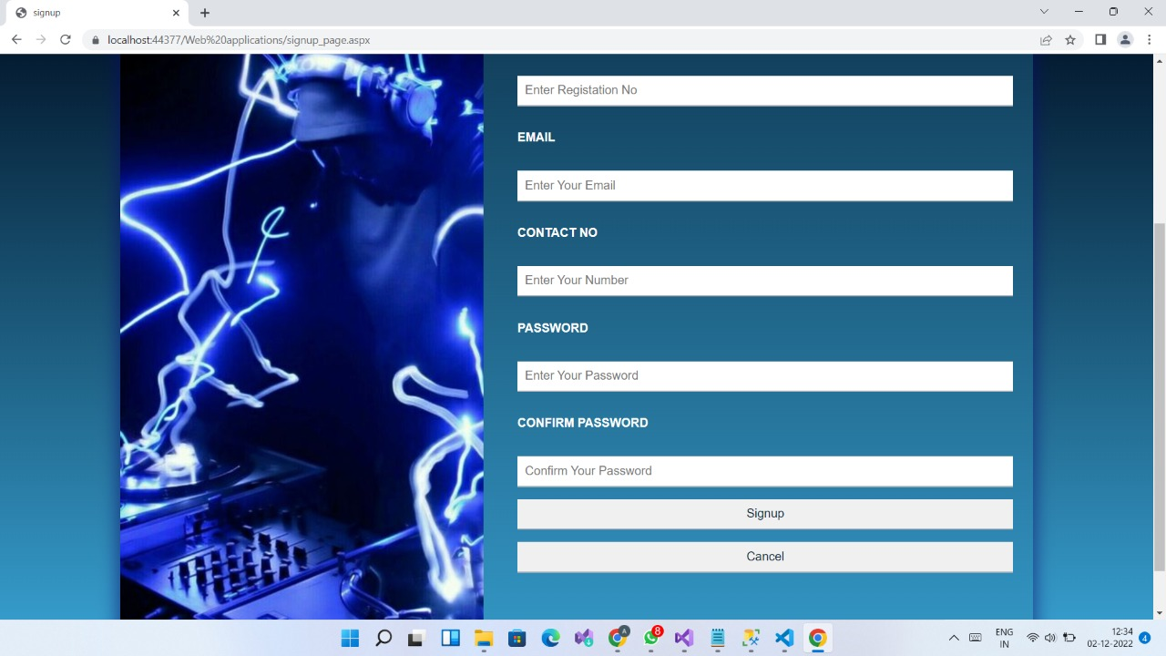
Sign Up Page
Sign up page for students having validation for each input and it is connected to database. User can enter details and then create their account and then login with credentials.

Slide 9
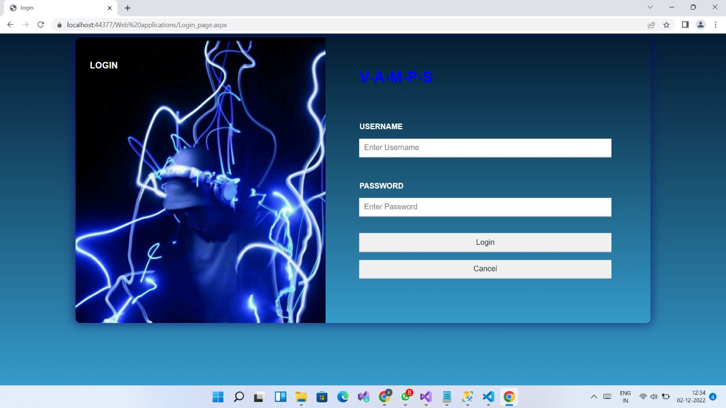
Login Page
This is login page which contains all validation for the inputs. By this user can enter inputs and they will be checked with database and user enters into respective dashboard whether it is a student, an organization or admin.

Slide 10
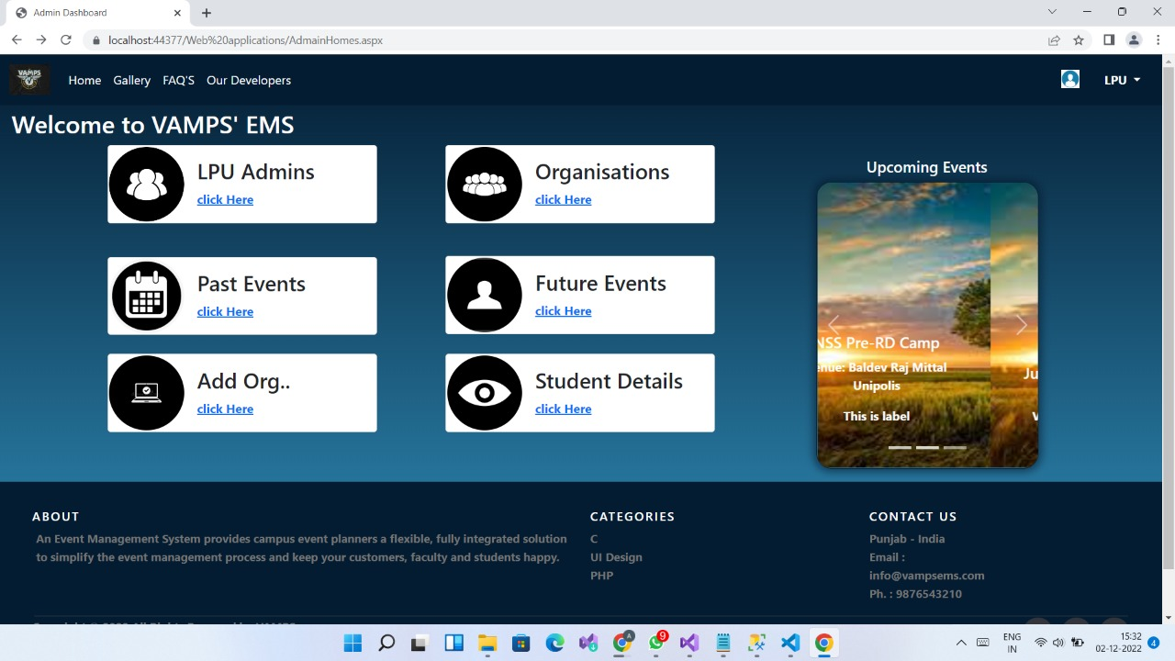
Admin Dashboard
When admin logins this dashboard opens. Admins credentials will be checked from database. He can check various important information like past events conducted, future events which will be conducted and he/she can also register the organization which wants to get registered and conduct events after going to add organization button. Admins can also access student details by going student details option

Slide 11
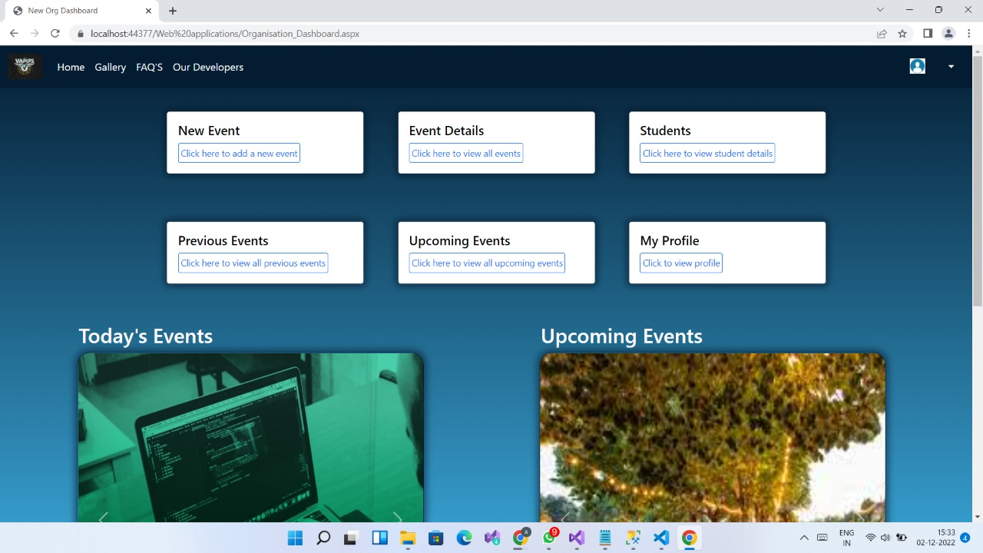
Organisation Dashboard
When an organization logins this dashboard will open where an organization can generate events and can also see the event details and can see the students who were registered for the events and they can also see past and future events which will be conducted in the institute.

Slide 12
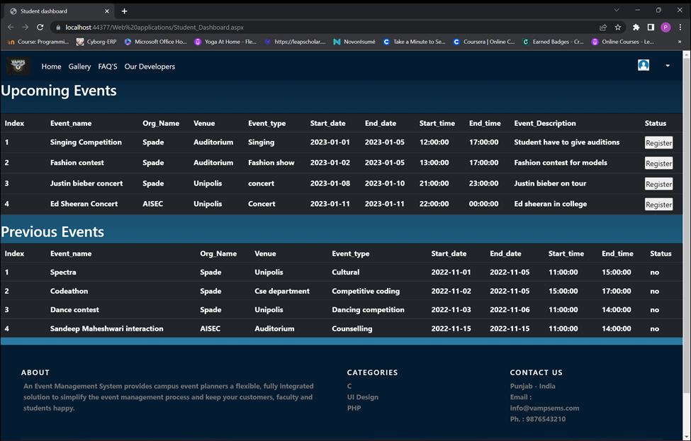
Student Dashboard
When a student logins this dashboard opens where the student can register for the upcoming events and can also see the previously held events.

